Slide 1
Exploring Android VQA:
Using Tensorflow To Assess Cognitive Visual Recognition
Team 16
Matthew Velazquez

Slide 2
Goals
One of the main objectives of CVRT is for physicians to be able to determine trends from patient data that could either be applicable to the individual patient, or to many patients if an aggregate is formed from many individual datasets. On an individual level, these metrics would provide a way for the physician to monitor daily cognitive capability, whereas on a grander scale, these joint datasets could be used to provide better overall treatment for the disease with the future inclusion of predictive analytics. As for short-term advantages, since this monitoring would be implemented daily, delirium can be more quickly identified as it could be the logical result of a sharp drop in image recognition capability.

Slide 3
Cognitive Visual Recognition Tracker (CVRT)
Builds on the existing VQA space to produce medically relevant metrics
Offers unique way to track the progression of Alzheimer’s disease through the following features:
- QA focused interface where users can select any image on their phone for questioning
- Charting that tracks patient’s image recognition ability over time
- Short-term monitoring that can detect delirium and advise for medical treatment
Combines the strengths of the COCO-QA dataset with Tensorflow and the Android UI to produce dynamic answers
Android WebView that reads SQLite database, calls Google Charting API, and displays meaningful metrics

Slide 4
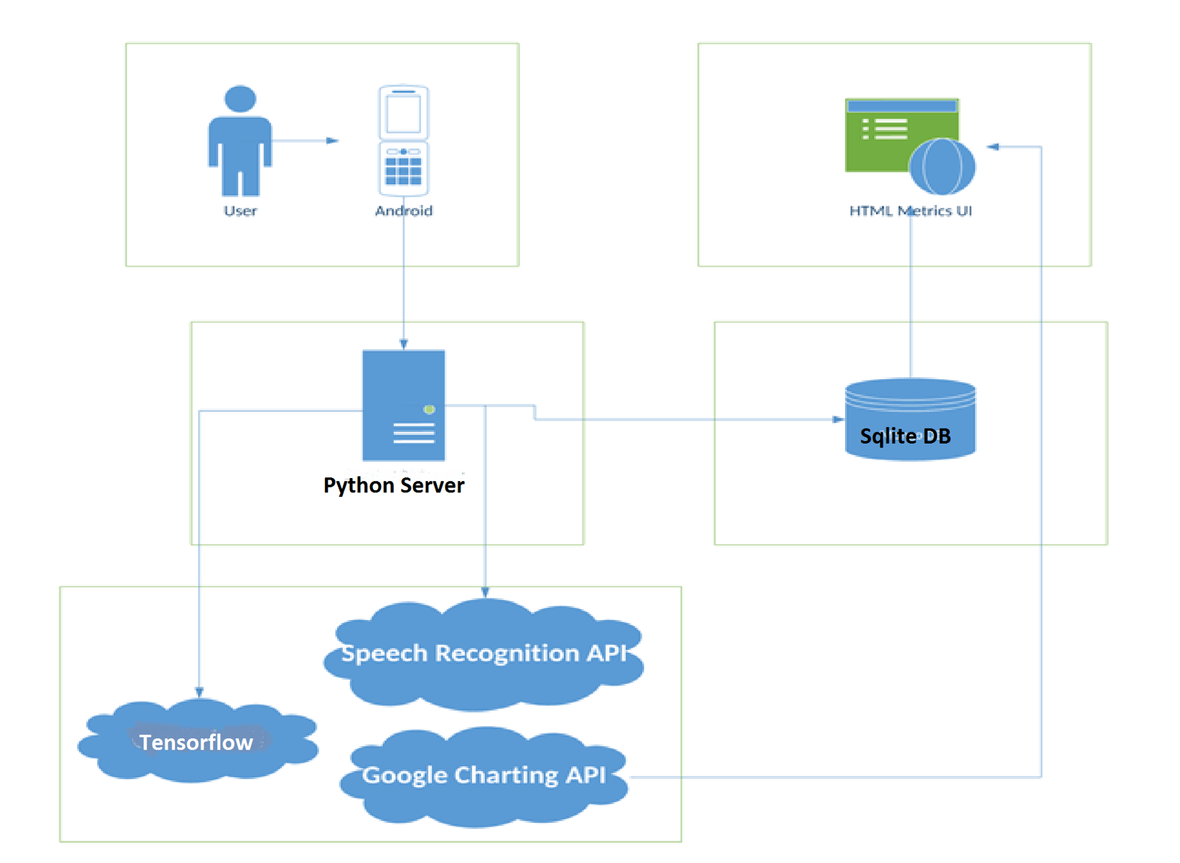
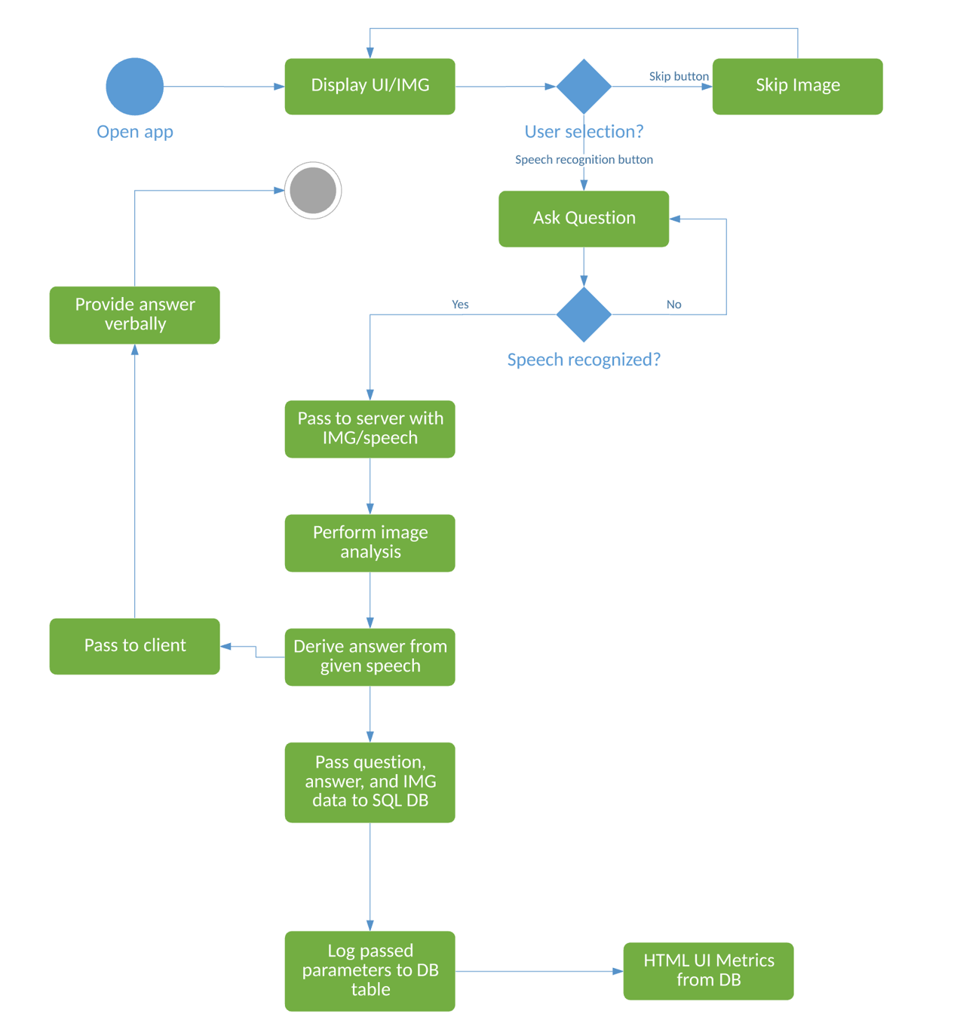
Architecture/Workflow

Slide 5
Results/Evaluation
Clarifai API achieved higher accuracy for basic image captioning, however, it was limited in that it could not a provide a dynamic QA platform.
CVRT added dynamic questioning ability with the integration of Tensorflow, and provided verbal feedback of the answer to the Android device after completion of server processing
An accuracy of 62% was achieved with dynamic questioning
All metrics/charting are generated on the client by combining the SQLite database and javascript/html within the Android UI.
Limited research has been done to show the impact of cognitive visual recognition tracking on a patient’s long-term/short-term mental health.
Future studies to focus on the semantic analysis to determine how the patient’s question vocabulary may change over time.

Slide 6
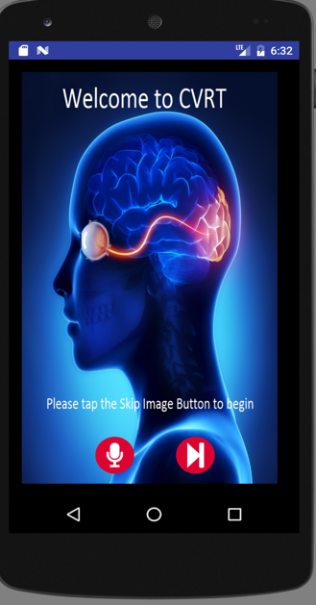
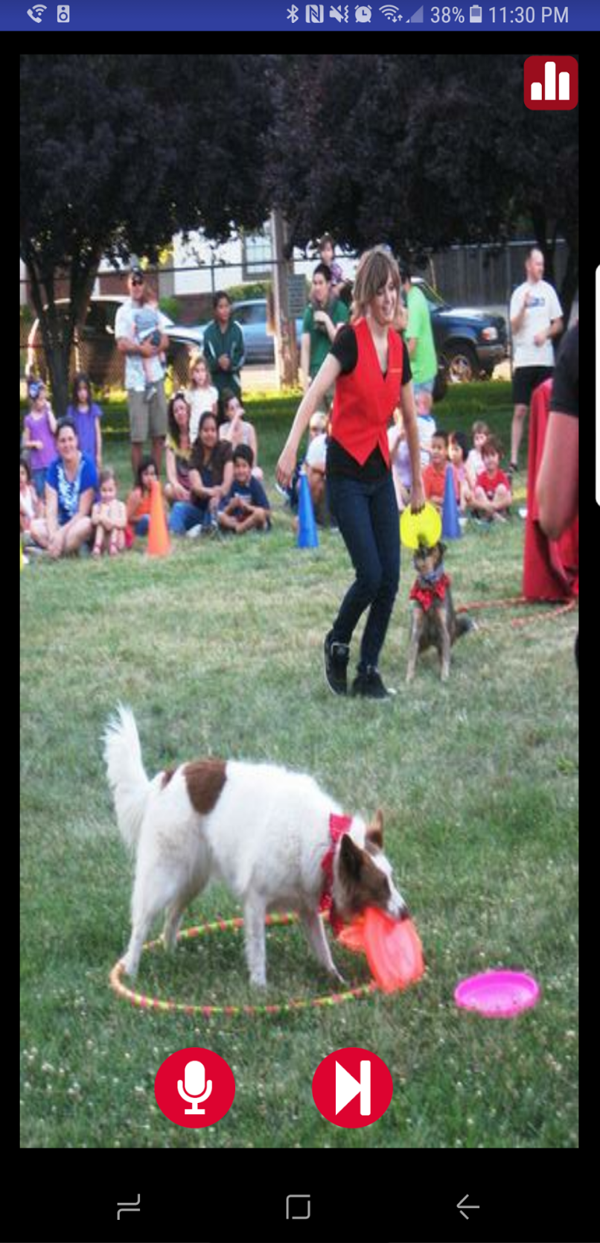
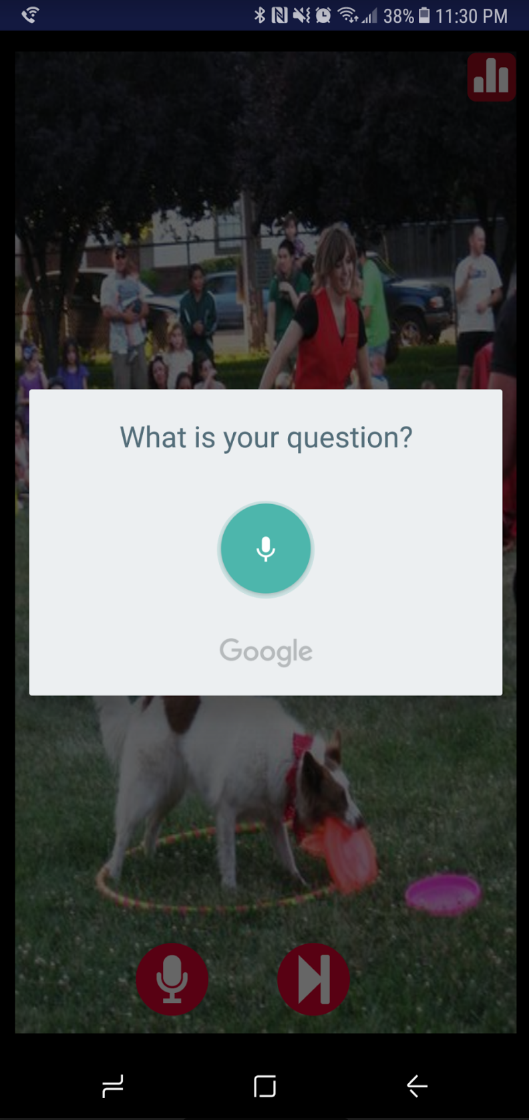
Implementation

Slide 7
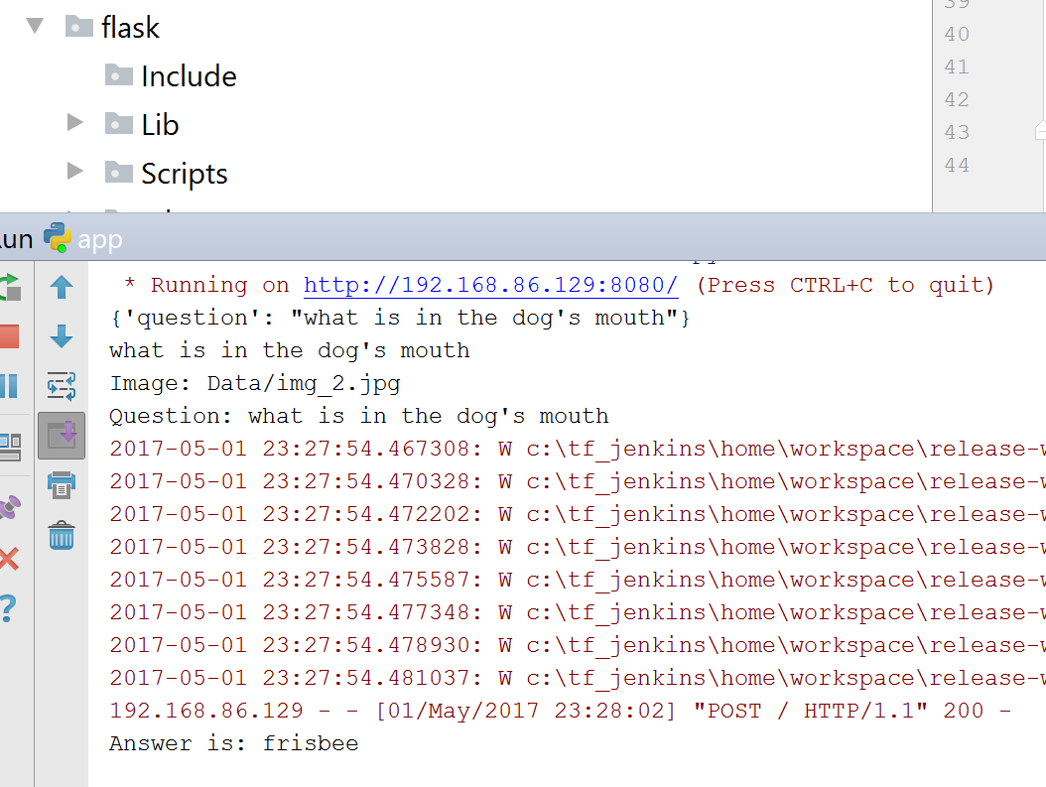
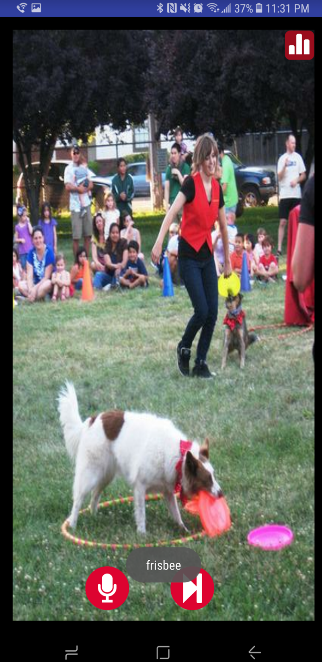
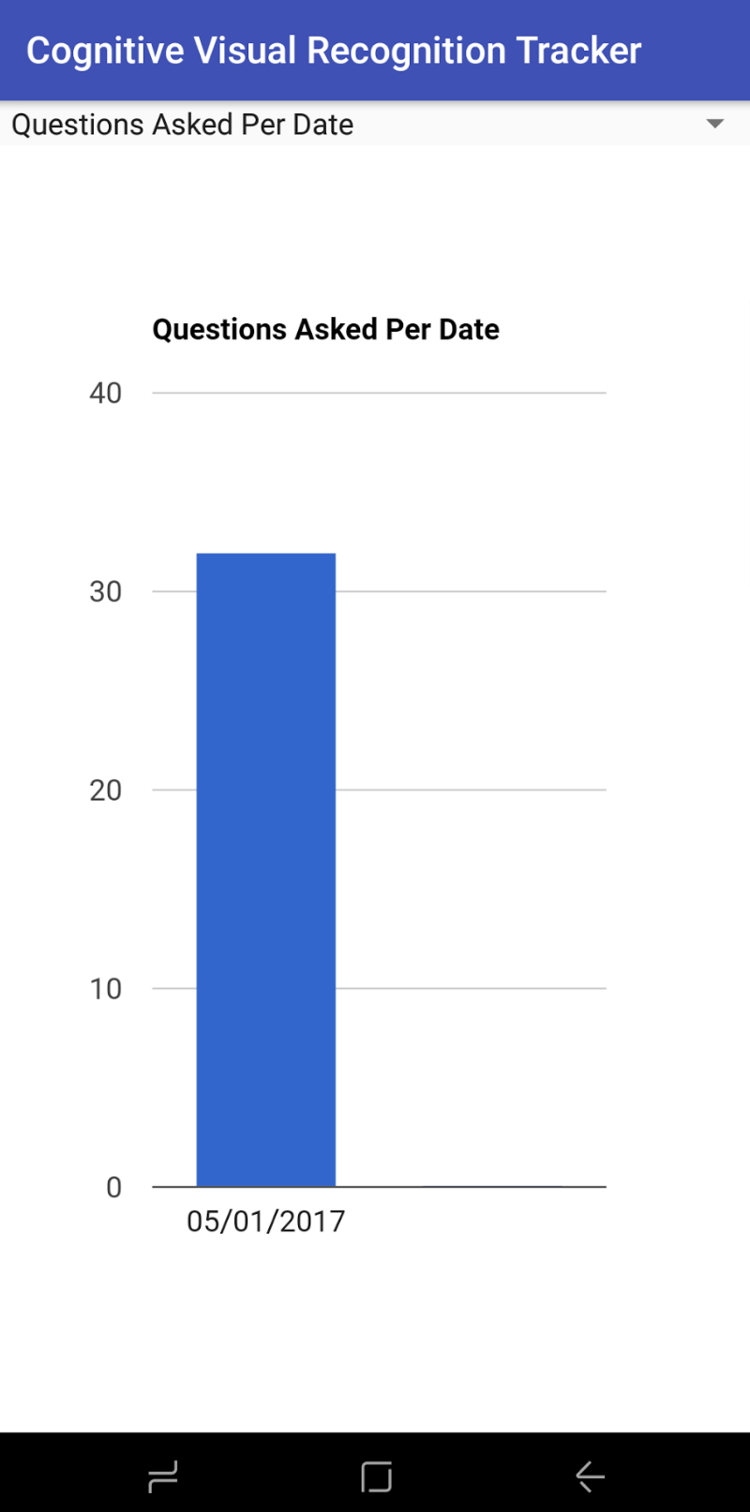
Implementation

Slide 8
THANK YOU

